Slide 1

Hillebrand Gori UK Limited,
Modern Slavery Statement
2025

Slide 2
Introduction from our Area Director
At Hillebrand Gori UK Limited, we recognise that the ongoing labour shortages, coupled with the changing nature of work, pose a risk of modern slavery for all businesses. As a global organisation, we are committed to maintaining the highest ethical standards in our operations and expect our suppliers to do the same.
The UK Modern Slavery Act 2015 outlines a host of measures to combat modern slavery and human trafficking. It requires businesses to hold themselves accountable through disclosure of steps that have been taken during the financial year to ensure such practices are absent from their operations and supply chains.
Part of the world’s largest leading logistics company, DHL Group, as an employer of choice, leads by example. Our Group Human Rights Policy Statement anchors minimum standards for fair working conditions and human rights in employee relations. The enforcement of this policy is supervised by the Senior Management Team, ensuring that the business understands its responsibility to uphold human rights, and we continue to integrate this into our operations and day-to-day behaviours.
Throughout 2025, our business has remained focused on ensuring the protection of human rights within both our own operations and our supply chain.
We have Human Rights training rolled out in the business, which is a mandatory training course. This is further reinforced via completion of mandatory Code of Conduct and Compliance Awareness training for all employees.
This statement is made pursuant to section 54(1) of the Modern Slavery Act 2015 and constitutes DGF’s Modern Slavery Statement for the financial year ending 31 December 2025
Steve Ansell
Area Director UK & Ireland
Hillebrand Gori UK Limited
30 April 2026

Slide 3
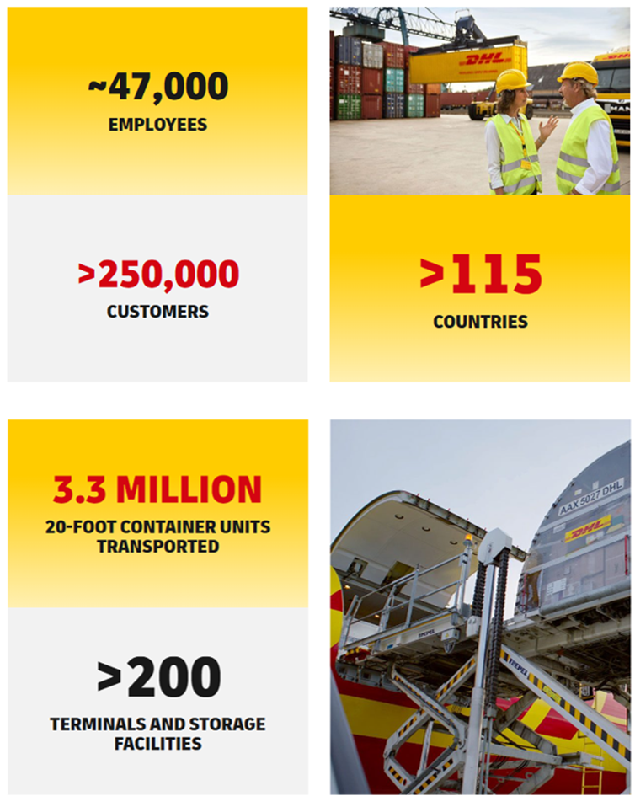
About DHL and our Supply Chains
DHL Group is the world’s leading logistics company with approximately 594,000 employees operating in over 220 countries and territories. The Group connects people and markets and is an enabler of global trade.
It aspires to be the first choice for customers, employees, investors, and green logistics worldwide. DHL contributes to the world through sustainable business practices, corporate citizenship, and environmental activities. We want to lead the way towards sustainable logistics – we want to be the Green Logistics of Choice, provide a great place to work for all, and be a highly trusted company and partner. As Investment of Choice, we plane to accelerate sustainable growth.
Hillebrand Gori, specialise in managing logistics for the global wine, beer and spirits industry. We are committed to making logistics easy and sustainable for everyone, and understand what these sensitive goods need, to preserve their quality while in storage or in transit. Our approach to beverage logistics is individual. We offer solutions based on customers’ need and ambition, to carefully manage any quantity, from a single bottle to bulk, along any route, across all modalities. Our offices are strategically located in every wind producing and consuming market around the world to offer the very best customer service. Hillebrand Gori operates in a network of over 115 countries with a team of over 2,000 freight forwarding specialists supporting global trade by transporting its customers’ goods by air, sea, road and rail. It also operates a customs brokerage service to support movement of its customers’ good cross-border. Hillebrand Gori place huge importance in ensuring that its services are provided in total compliance with local regulations and legislation.
As part of the DHL Group, Hillebrand Gori is fully aligned with all Group policies and practices in relation to responsible business practice and human rights standards, including those in relation to forced labour and modern slavery.
In the UK, we operate at 4 office only locations to ensure a comprehensive coverage of the UK..

Slide 4

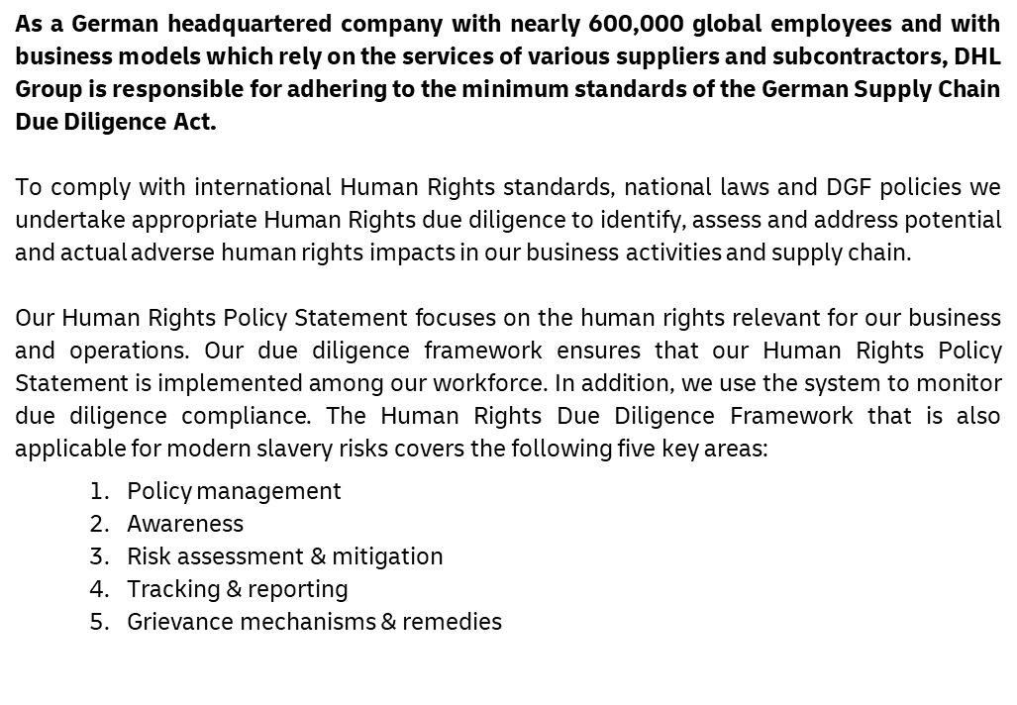
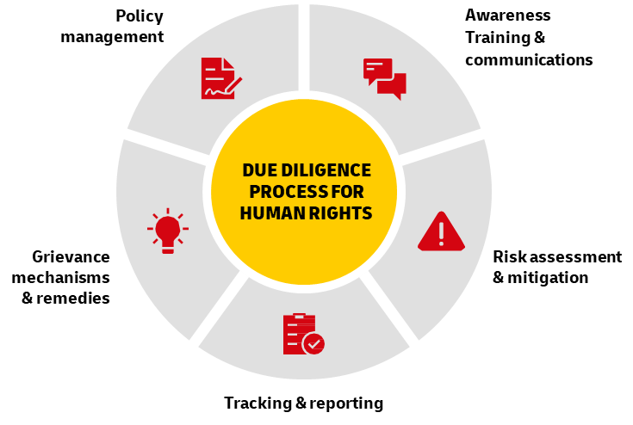
Our Due Diligence

Slide 5

Policy Management
The following policies are in place in relation to slavery and human trafficking:
Human Rights Policy Statement
The importance DHL Group places on human rights topics is displayed by the Human Rights Policy Statement issued by the Corporate Board which is based on the UN Global Compact, the Universal Declaration of Human Rights, the International Labour Organization’s Declaration on the Fundamental Principles and Rights at Work, the OECD Guidelines for Multinational Enterprises, the UN Guiding Principles on Business and Human Rights and the UN Sustainable Development Goals.
The Human Rights Policy statement anchors minimum standards for fair working conditions and human rights in employee relations.
Code of Conduct
Our Code of Conduct reflects the business corporate values “Respect & Results”. The rules and standards outlined in the Code serve as an “ethical compass” that guides all employees worldwide in their day-to-day work. There is no alternative to conducting our business in a responsible, fair and ethically irreproachable way. DHL Group Board of Management endorses the values outlined in the Code of Conduct and expects all employees, executives and managers to be role models in their daily work and to contribute to a corporate culture characterised by respect. The Code of Conduct is binding for all regions and business units of the DHL Group.
Supplier Code of Conduct
The Supplier Code of Conduct is a reflection of the ethical, social and environmental standards we set for ourselves, and it is a binding component of our relationships with all suppliers, including subcontractors. By accepting it, the supplier/subcontractor undertakes to comply with our standards and to implement them in its own supply chain. For more detailed information on the Supplier Code of Conduct, please click here.
We consider as an accepted SCoC the following:
Our own Supplier Code of Conduct
If the supplier has implemented a code of conduct that we classify as equivalent
If both contracting parties are supplier and customer at the same time, they can mutually recognise each other’s own company code of conduct, provided they have been classified as equivalent.
In DHL Group we measure our ability to enforce compliance with our standards in the upstream value chain with the metric “Supplier spend covered by an accepted SCoC”. In reporting year 2024 this metric increased to more than EUR 39 billion (2023: > 35 EUR billion). This corresponds to a share of >90% of eligible procurement expenditure.
Prevention of Illegal Working
This policy outlines the DHL approach to ‘Employing Young Adults’ stipulating that generally the Company does not employee anyone under 18 years of age, except for individuals aged 16 or 17 employed on an apprenticeship or working within an office-based environment.
Whistleblower Policy
This policy outlines the mechanism in place which allows anyone to raise concerns around modern slavery, forced labour and human trafficking and includes how individuals raising a concern will be protected from retaliatory behaviour for blowing the whistle under UK regulations.

Slide 6

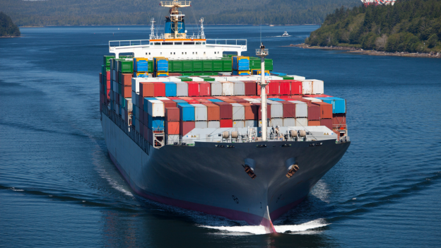
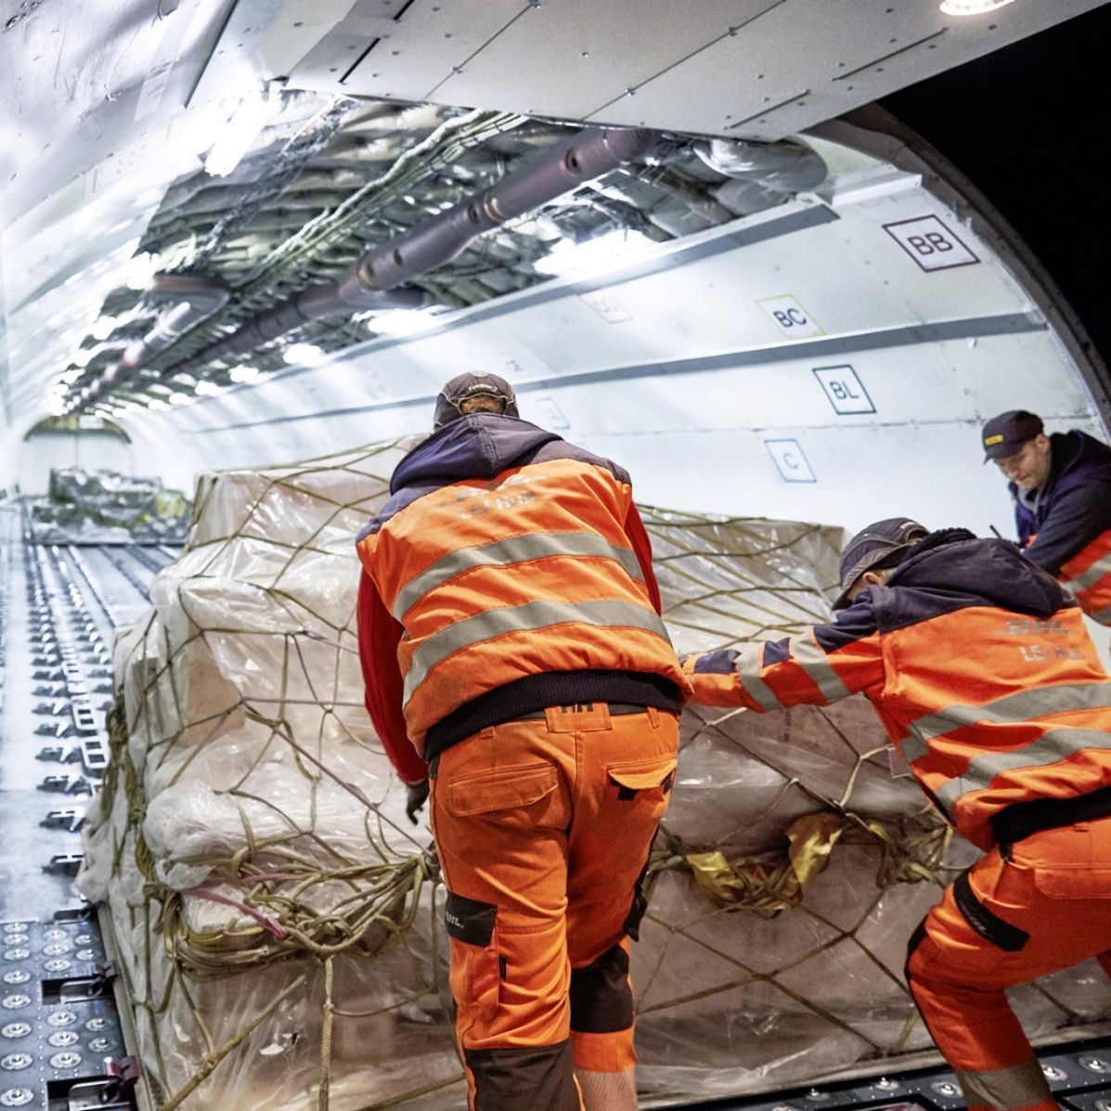
2. Awareness
Raising awareness of modern slavery, both within our business and our supply chains is an important part of our due diligence framework.
Our People
All new joiners are inducted into the core principles of the DHL Code of Conduct.
Building Great Employee Relations training: We train managers, supervisors and HR professionals on the importance of creating and delivering people practices which develop and maintain a positive climate of employee relations, with people practices that are fair, legally compliant and fit for purpose.
Human Rights e-learning: All senior management are required to complete this training every two years to ensure ongoing awareness and understanding of ethical standards, human rights, labour rights, and the prevention of modern slavery and human trafficking.
The role of HR in Human Rights Due Diligence – operational HR teams are trained in recognising Human Rights risk, including prevention of forced and child labour
Supplier Code of Conduct (SCoC) e-learning: All senior management and procurement employees are required to complete this training every two years to understand the importance of the SCoC set of strict ethical standards for doing business with our suppliers.

Slide 7

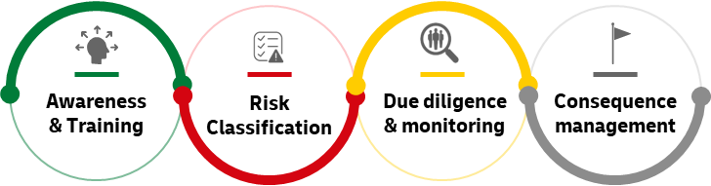
3. Risk Assessment & Mitigation
DHL believe there is a low level of risk in relation to Modern Slavery in Hillebrand Gori operations. DHL’s own operations are assessed on an annual basis through internal programmes. Corporate Procurement establishes procurement standards, policies and procedures related to suppliers within the DHL Group.
DHL Operations
DHL have a number of programmes to ensure safe operations. These include:
Annual Human Rights Country risk assessment
Internal Control System
Internal Audit and Review programmes
Supplier Due Diligence and Risk Assessment Process
The minimum requirements for risk assessment are based on risk potential, which we re-evaluate annually depending on the procurement category and the geographical location of the supplier.
The risk assessment is influenced by the procurement category and various other types of risk within the relevant risk domains ESG, the economy, technology, law and politics, and cybersecurity.
Other factors such as diversity and respect for human rights, in addition to external criteria for determining risk potential such as the Corruption Perception Index issued by Transparency International and/or Verisk Maplecroft’s risk classification system are also considered. The final assessment of risk potential is based on an evaluation of the probability of occurrence and possible impact.
The Group-wide risk management system for supplier evaluations (Shield) is continuously reviewed for potential improvements and adjusted as necessary.
Our assessment procedure is flexible and adaptive and therefore takes account of the different requirements of our business models. The following evaluation tools can be used individually or in combination with each other, depending on the requirements of the specific tendering process, or they may be used to review existing contractual relationships
Supplier Management Evaluation Tools
      • Self-assessment questionnaires
      • Virtual or onsite audits
      • Certification issued by a third party
      • Risk rating issued by a third party
      • Checking suppliers against sanctions lists
If supplier practices are identified that are not in line with our standards, this could result in the supplier being excluded from tenders. Should a serious breach or material shortcoming be identified among existing suppliers, we jointly agree on specific actions for improvement with the supplier and follow up on their implementation. We reserve the right to terminate the supplier relationship if we do not identify sufficient improvements when re-assessing the supplier

Slide 8
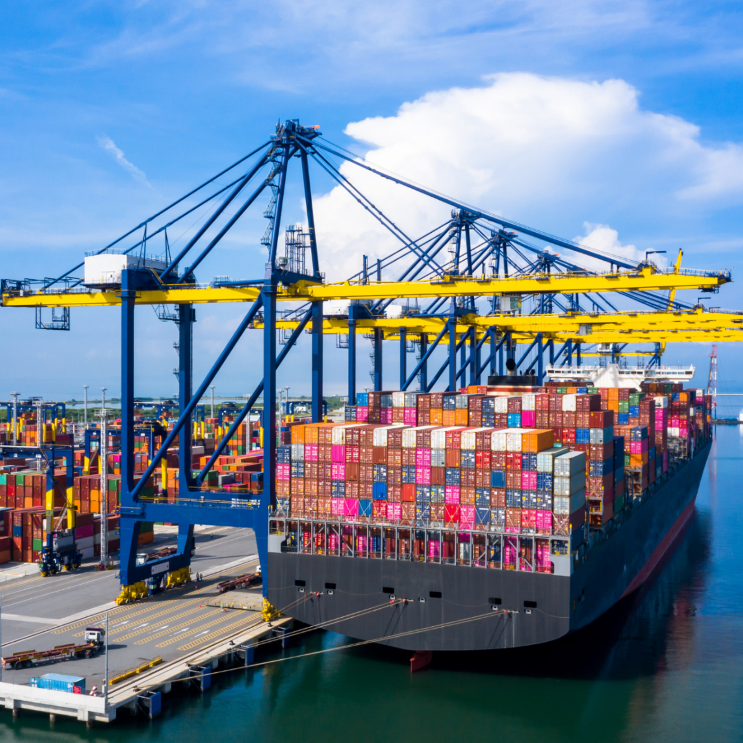
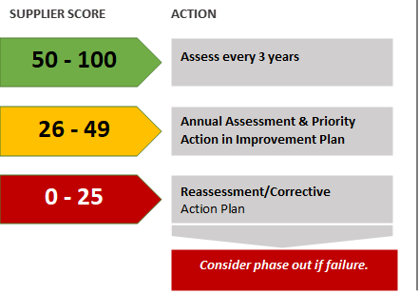
3. Risk Assessment & Mitigation
Identified Key Risk Areas
DHL Group, for the year under review, has assessed five supplier categories defined as higher risk for the areas covered by our Human Rights Policy Statement:
Road transport
Uniforms and personal protective equipment
Temporary Labour & Output Based Services
Promotional items
Building renovations and new constructions
DHL Group uses a Supplier Risk Management Tool. This tool serves as the single point of access for all risk management activities for suppliers. Assessment scores stored in this tool include but are not limited to a Due Diligence Questionnaire (DDQ) or external supplier evaluation such as EcoVardis.
The Supplier Risk Management Tool presents all available risk assessments of a supplier according to a consistent logic. Suppliers who score between 0 and 25 will be classified as high-risk suppliers and a Corrective Action Plan (CAP) will need to be formulated and agreed between all stakeholders.
The expectation is that the supplier will complete this in an agreed timeframe and then undertake a new Assessment. Should the supplier not engage or complete the CAP to a satisfactory level, the supplier may be off-boarded. For those Suppliers who score between 26 to 49, they will be classified as medium-risk supplier and will need to implement their own CAP and be reassessed in 12 months. Suppliers who score 50 or above will be classified as low-risk suppliers and will have to be reassessed in 36 months.

Slide 9
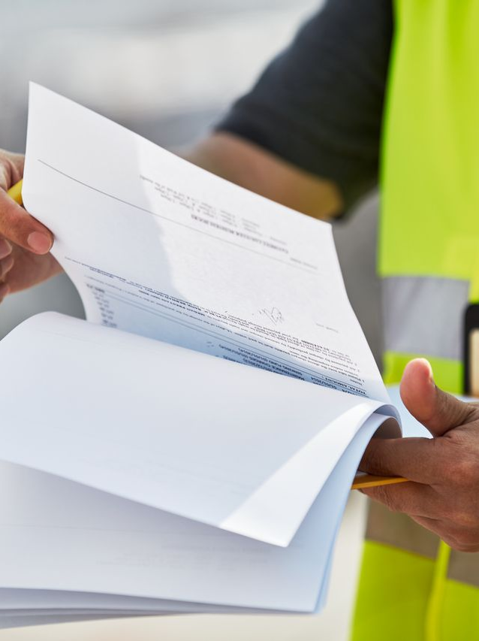
4. Tracking and Reporting
Corporate Governance and Monitoring
We communicate and report on our human rights related commitments, activities and statements, as part of DHL Group’s annual reporting. DGF regularly evaluates and reviews how best to improve and strengthen our approach to addressing human rights in our sphere of influence.
Effectiveness of the Compliance Incident Reporting System
Identification and management of non-compliance are essential in implementing certain corporate governance principles and standards, specifically provisions on the fight against human rights violations, corruption, and criminal law. In this reporting year, there have been no compliance issues raised in relation to modern slavery through these processes either regarding our own operations or the supplier base in Hillebrand Gori.
Internal Awareness and Training Programs
Comprehensive awareness and training at all levels and all locations are the most effective means to mitigate risks and protect DGF and its employees.
Reporting
It is each employee’s personal responsibility to report any actual or suspected violations of our Human Rights Policy. Violations include not only non-compliance, but also a failure by the responsible management to detect and/or report offences. Reporting channels include the employee’s line manager, local management, the Human Resource department, the Compliance Officer, Legal Department or the ‘Speak Up’ compliance incident management system.

Slide 10

5. Grievance mechanisms and remedies
Compliance Incident Reporting System
The group operates a professional Compliance Incident Reporting System where employees and third parties can share concerns/issues , including matters relating to labour practices or breaches of human rights. All reported violations are handled confidentially. Any matter raised is investigated by an independent investigation team.
If it is determined that there is a risk of adverse human rights impact caused or contributed to by our business activities, we have a procedure in place to ensure the activity is assessed, changed, discontinued and/or remediated. We encourage our employees to address suspected violations of this modern slavery policy statement through the established accessible grievance or dispute resolution channels including local management, responsible Human Resources departments or the Compliance Incident Reporting System. Our partners and third parties can also access the reporting portal via Home - BKMS System (bkms-system.com) to report potential violations of our Human Rights Policy Statement. The system also offers various local telephony lines. The system can be used anonymously as well.
Consequences of a breach
If infringements against our policies are reported, we will take appropriate measures for proper clarification of the circumstances of the breach. We will take corrective actions where appropriate. Consequences under civil and criminal law will depend on how and in what circumstances an individual has contravened our policies. Where a breach of legislation is proven in this regard, we also reserve the right to refer the matter to the relevant authorities for further action. An allegation or violation of our Supplier Code of Conduct and/ or standards, may prompt an investigation or inquiry. Should sufficient evidence come to light, we will take appropriate action as the circumstances may require. Any consequences applied will depend on the severity and in line with our internal Supplier Incident Management Process.

Slide 11

Next Steps
Hillebrand Gori will continue to monitor the modern slavery risk through continued risk assessment and due diligence, both in its own operations and suppliers. It will continue to monitor its supplier's compliance with obligations committed to in the Supplier Code of Conduct through a risk-based schedule of assessments.
  Our focus throughout 2026 and beyond will be to:
  Continue to assess our suppliers using the internal Supplier Due Diligence process, along with continuing to work with high-risk suppliers in developing adequate risk controls.
  Complete ethical trade audits of in scope labour providers and implement action plans for improvement where required.
  Following the successful implementation of Human Rights Due Diligence in Human Resources training in 2024, build closer collaboration with our customers to provide assurance that our operations incorporate industry recognised Ethical Trade Standards, which incorporate assessments on Modern Slavery risks.

Slide 12
Approval and Signature
Name : Steve Ansell - Area Director UK & Ireland
Name of Company : Hillebrand Gori UK Limited

